Slide 1
R
Code Profiling

Slide 2
Profvis
Interactive Visualizations for Profiling R Code
Overview
install.packages("profvis")

Slide 3
Profvis is a tool for helping you to understand how R spends its time. It provides a interactive graphical interface for visualizing data from Rprof, R’s built-in tool for collecting profiling data.

Slide 4
Suppose you make a loop run 5 times faster. That sounds like a huge improvement, but if that loop only takes 10% of the total time, it’s still only a 8% speedup overall.

Slide 5
library(profvis)
profvis({
data(diamonds, package = "ggplot2")
plot(price ~ carat, data = diamonds)
m <- lm(price ~ carat, data = diamonds)
abline(m, col = "red")
})

Slide 6
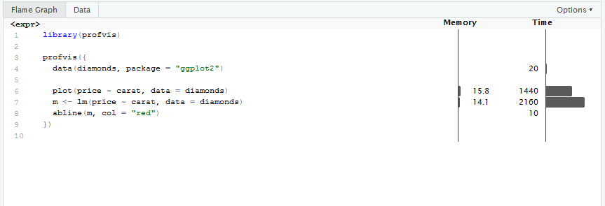

Slide 7
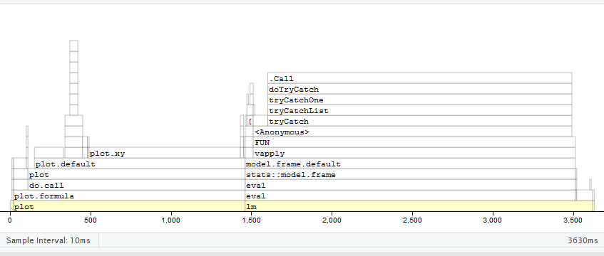

Slide 8
Memory: Memory allocated or deallocated (for negative numbers) for a given call stack. This is represented in megabytes and aggregated over all the call stacks over the code in the given row.
Time: Time spent in milliseconds. This field is also aggregated over all the call stacks executed over the code in the given row.

Slide 9
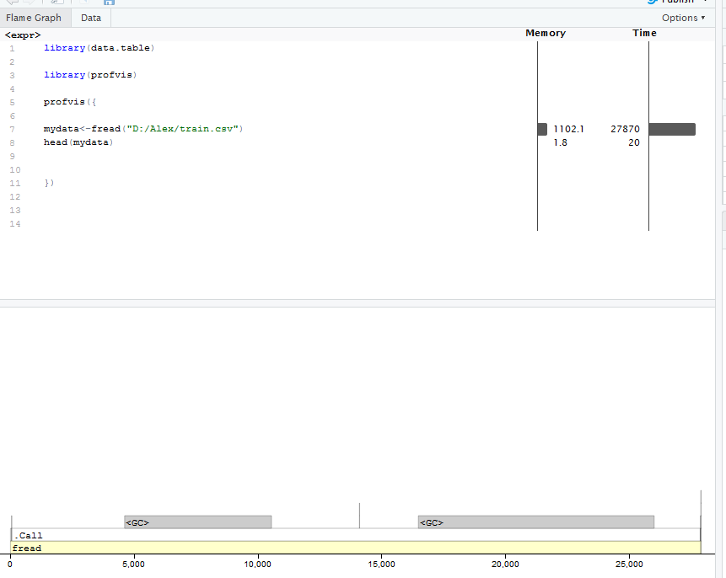

Slide 10
library(data.table)
library(profvis)
profvis({
mydata<-fread("D:/Alex/train.csv")
head(mydata)
})

Slide 11
The profiler is composed by two main tabs:
Flame graph
Data

